Slide 1

Air Quality Index Forecasting via Genetic Algorithm-Based Improved Extreme Learning Machine
UNDER THE GUIDENCE OF
Mr. Chiranjeevi
(B.Tech,M.Tech)
HEAD OF DEPT Mr. KLSDT Keerthi Vardhan
(M.Tech, (PhD))
PRESENTED BY
D.RAMADEVI (21TP1A6715) G.VENKATESH (21TP1A6718)
G.SAI DIVYA (22TP5A6703) D.SAI PRASHANTH (21TP1A6713)

Slide 2
CONTENTS
ABSTRACT
INTRODUCTION
EXISTING SYSTEM
PROPOSED SYSTEM
SYSTEM ARCHITECTURE
SOFTWARE REQUIREMENT
SYSTEM DESIGN
IMPLEMENTATION CODE & SCREEN SHOTS
CONCLUSION
FUTURE ENHANCEMENT
REFERENCES

Slide 3

ABSTRACT
This project introduces a hybrid model combining Genetic Algorithms (GA) and Extreme Learning Machines (ELM) for precise Air Quality Index (AQI) forecasting. GA optimizes ELM parameters like hidden neurons and input weights, enhancing generalization and capturing complex nonlinear patterns in air quality data. The approach supports effective mitigation strategies for environmental and public health challenges.

Slide 4
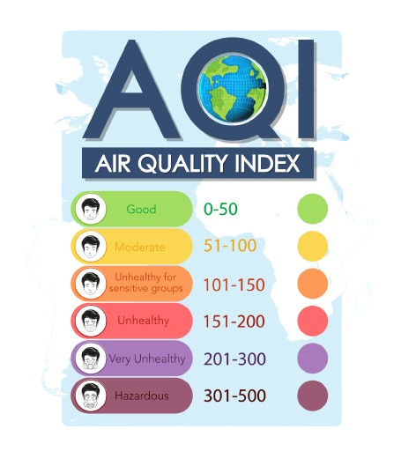
INTRODUCTION
Air quality impacts health, ecosystems, and life quality, with industrialization worsening pollution globally. Accurate AQI forecasting is crucial, but traditional methods struggle with complex, nonlinear data.
This study presents a hybrid model combining Extreme Learning Machine (ELM) and Genetic Algorithm (GA) for accurate AQI forecasting. GA optimizes ELM's parameters, leveraging its speed and ability to handle high-dimensional data.
The hybrid model combines ELM's efficiency with GA's optimization, offering superior accuracy over traditional methods. It supports informed decisions on pollution control, public health, and sustainability, with detailed results provided.

Slide 5
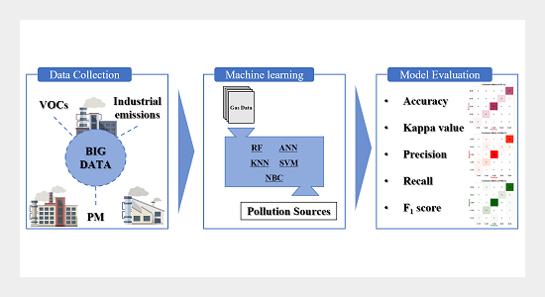
EXISTING SYSTEM
Current AQI forecasting relies on traditional methods like regression and time series analysis, which struggle with nonlinear, complex, and high-dimensional data. These methods lack accuracy, fail to adapt to dynamic patterns, and are computationally inefficient. This highlights the need for more advanced and reliable forecasting techniques.
The shortcomings of current methods limit timely and informed decisions on pollution control, public health, and environmental policies. Advanced models are needed to address computational inefficiency and data complexity.
The proposed ELM-GA hybrid
model offers a promising solution.

Slide 6

PROPOSED SYSTEM
The proposed system integrates Genetic Algorithm (GA) with Extreme Learning Machine (ELM) to enhance weight accuracy and network performance.
GA optimizes hidden nodes, thresholds, and weights, addressing limitations of conventional ELM. Using RMSE in the fitness function and iterative optimization, it improves model accuracy effectively.
ADVANTAGES
High Accuracy

Slide 7
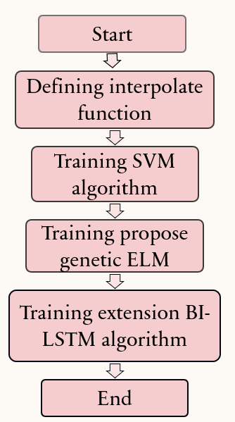
SYSTEM ARCHITECTURE
Stages in SDLC:
Requirement Gathering
Analysis
Designing
Coding
Testing
Maintenance

Slide 8
SYSTEM REQUIREMENTS
HARDWARE REQUIREMENTS:
Processor - Intel i3 or higher
Storage - 512 SSD
Speed - 1.1 GHz
RAM - 4 GB (min)
Hard Disk - 500 GB (min)
GPU - IRISxe 4 GB
Key Board - Standard Windows Keyboard
Mouse - Two or Three Button Mouse
Monitor - SVGA

Slide 9
SOFTWARE REQUIREMENTS:
Operating System - Windows 10 or above
Programming Language - Python with Jupiter notebook

Slide 10
SYSTEM DESIGN
CLASS DIAGRAM :

Slide 11
SYSTEM DESIGN
SEQUENCE DIAGRAME :

Slide 12
SYSTEM DESIGN
COLLABORATION DIAGRAME :

Slide 13
SYSTEM DESIGN
COMPONENT DIAGRAM:

Slide 14
SYSTEM DESIGN
DEPLOYMENT DIAGRAME :

Slide 15
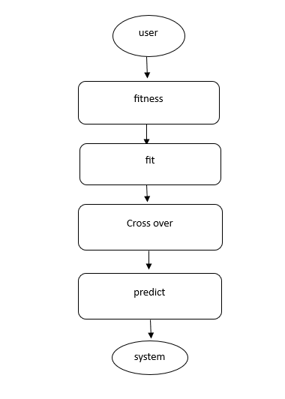
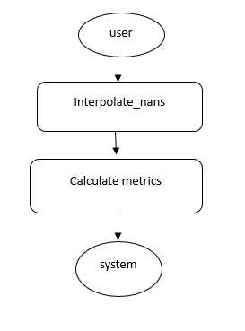
SYSTEM DESIGN
ACTIVITY DIAGRAME :

Slide 16

IMPLEMENTATION CODE

Slide 17

IMPLEMENTATION CODE

Slide 18

OUTPUT SCREENSHOTS

Slide 19
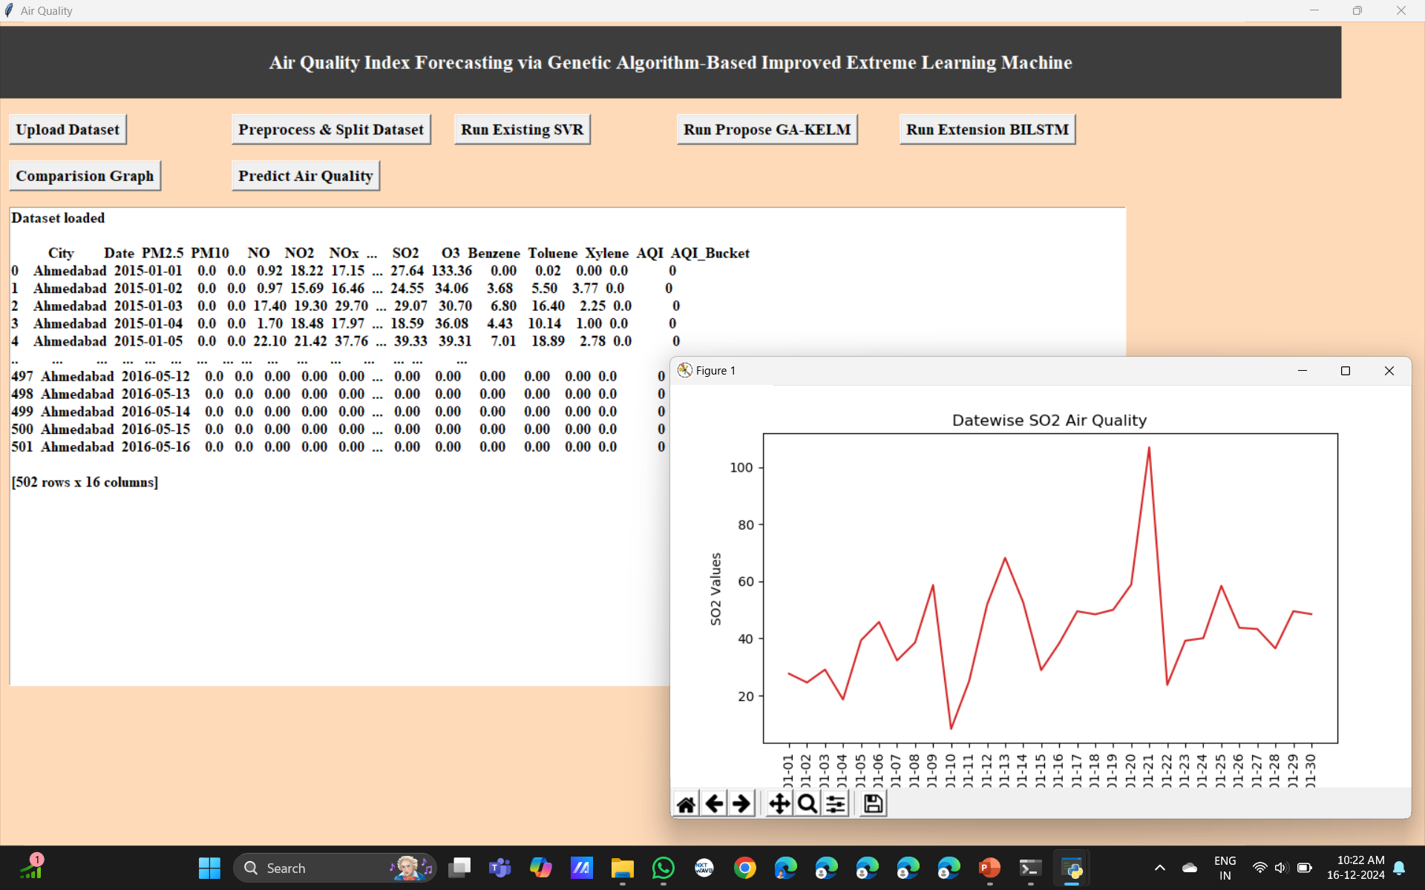
OUTPUT SCREENSHOTS

Slide 20

OUTPUT SCREENSHOTS

Slide 21
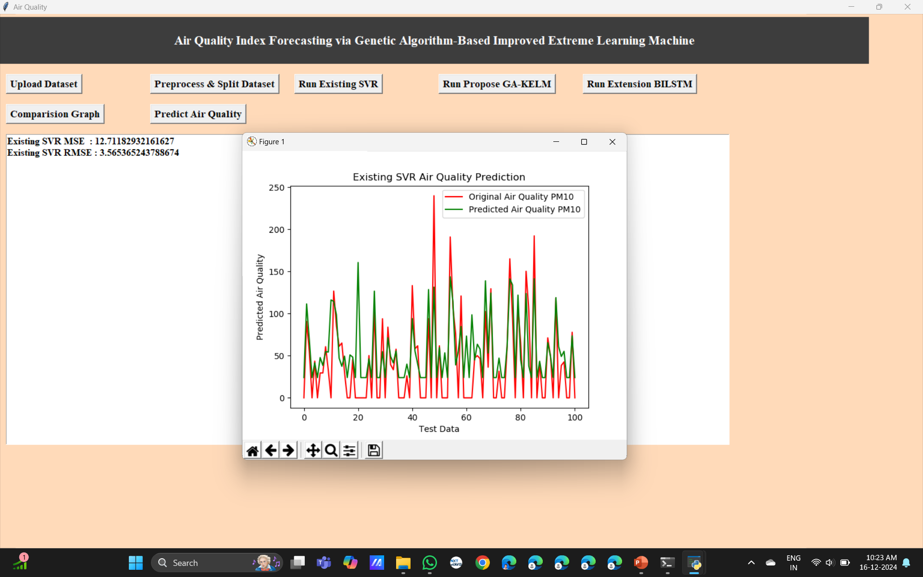
OUTPUT SCREENSHOTS

Slide 22
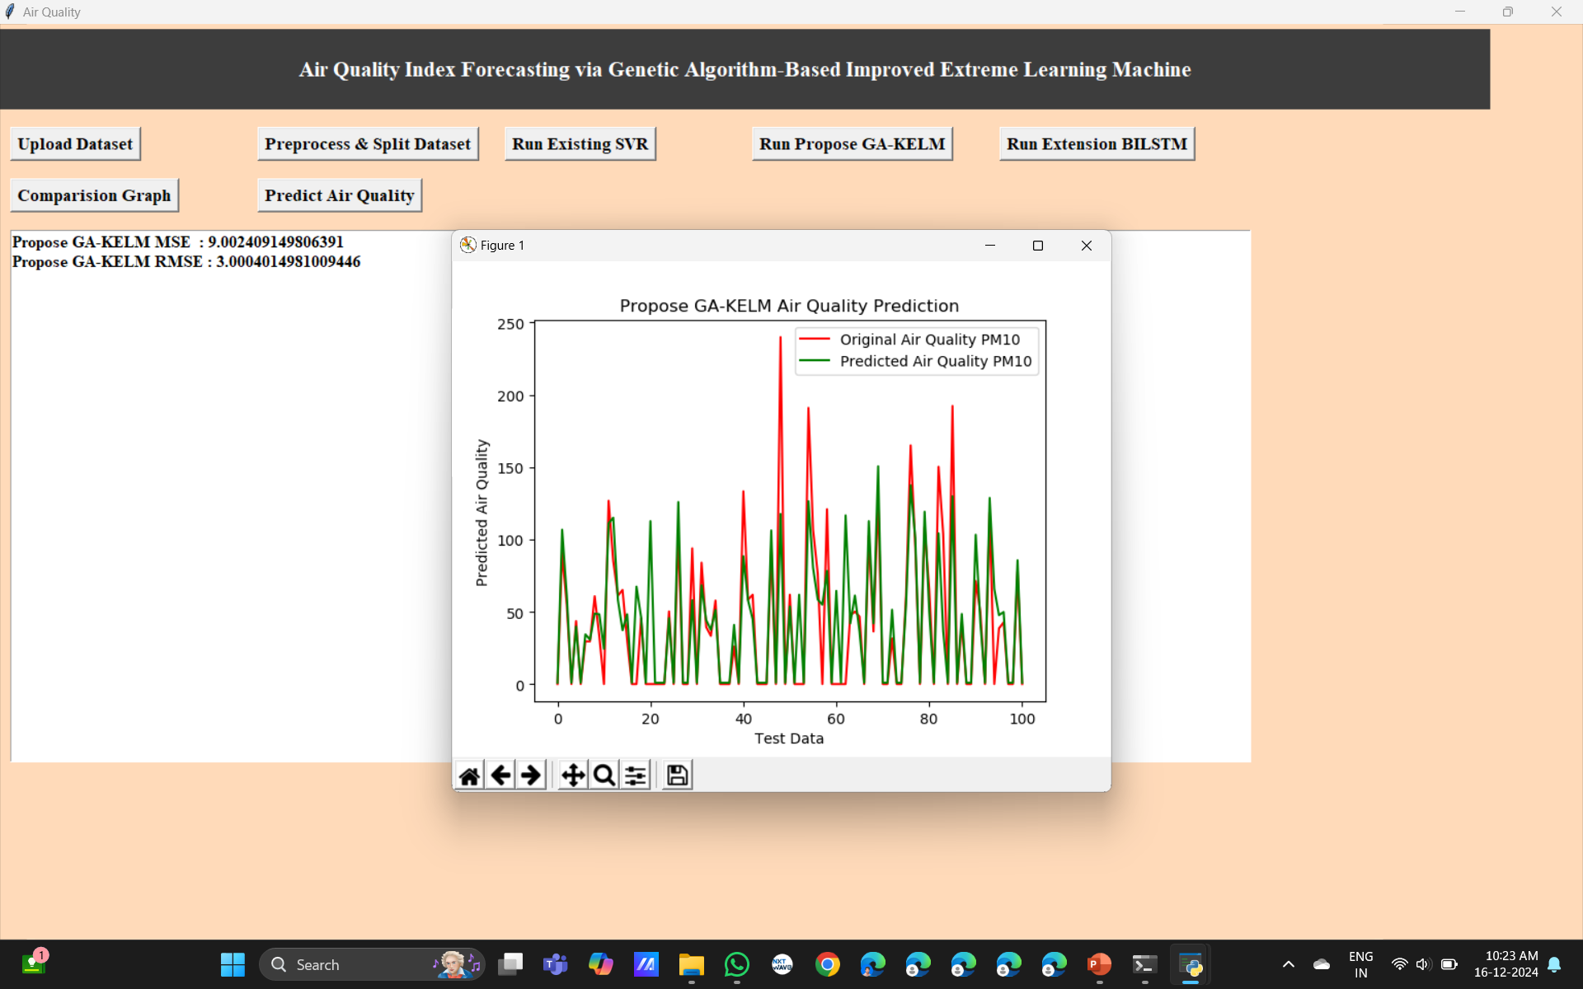
OUTPUT SCREENSHOTS

Slide 23
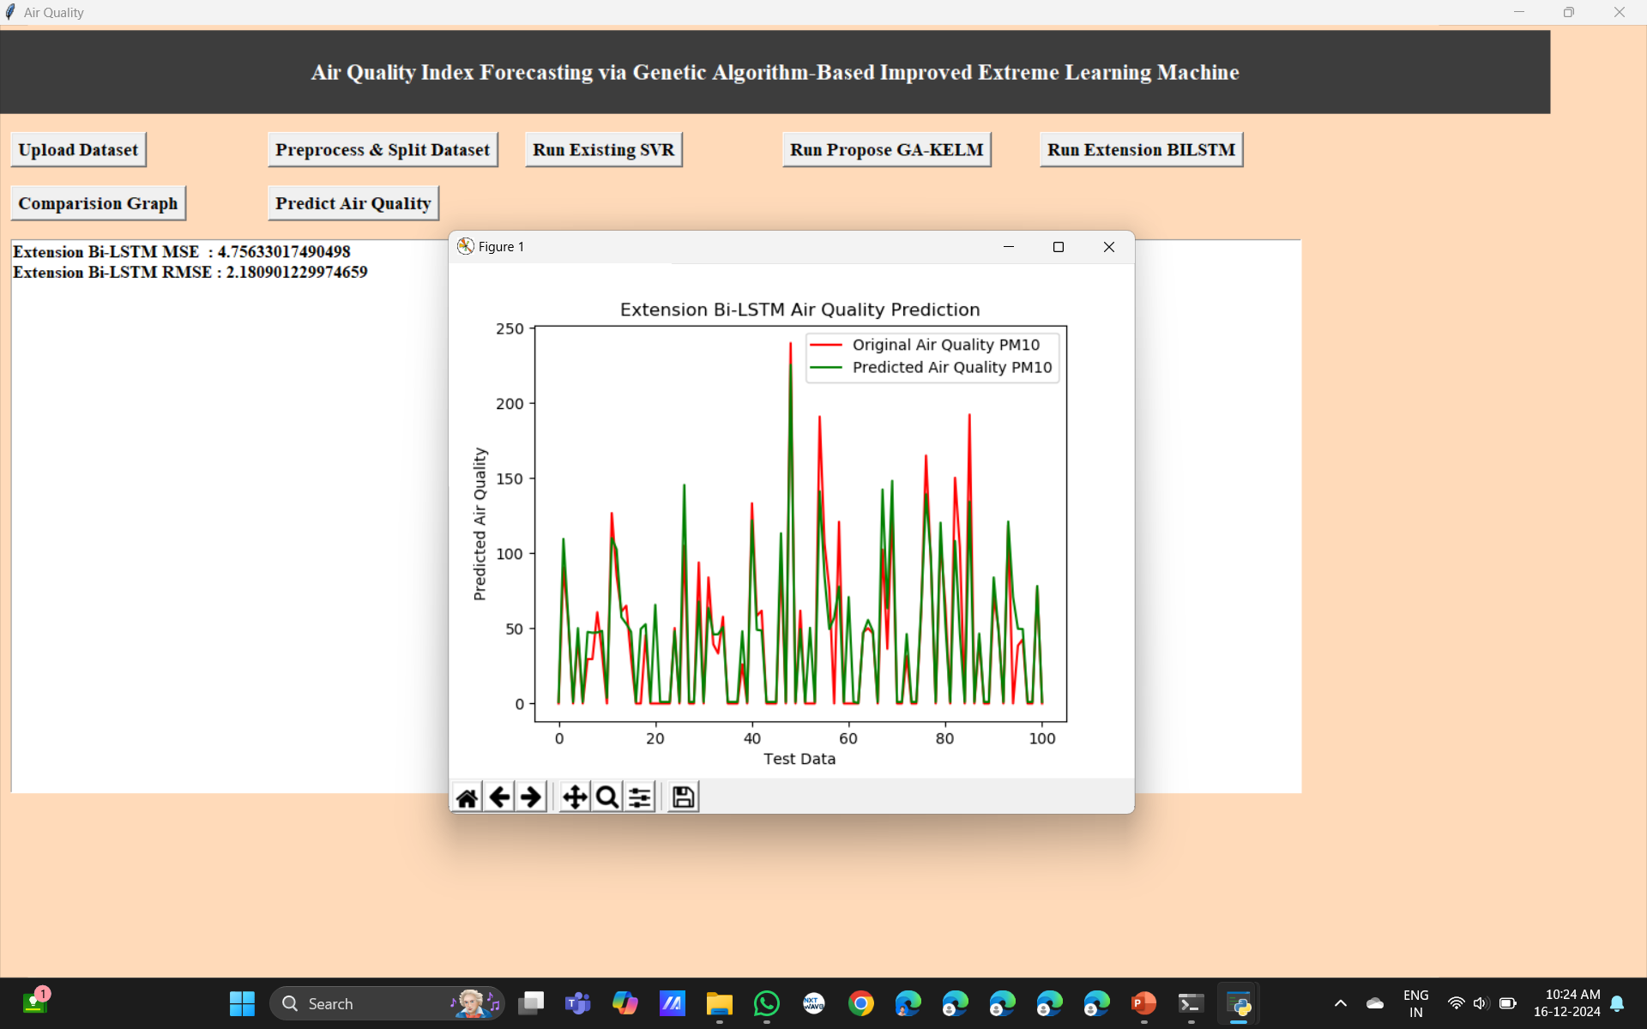
OUTPUT SCREENSHOTS

Slide 24
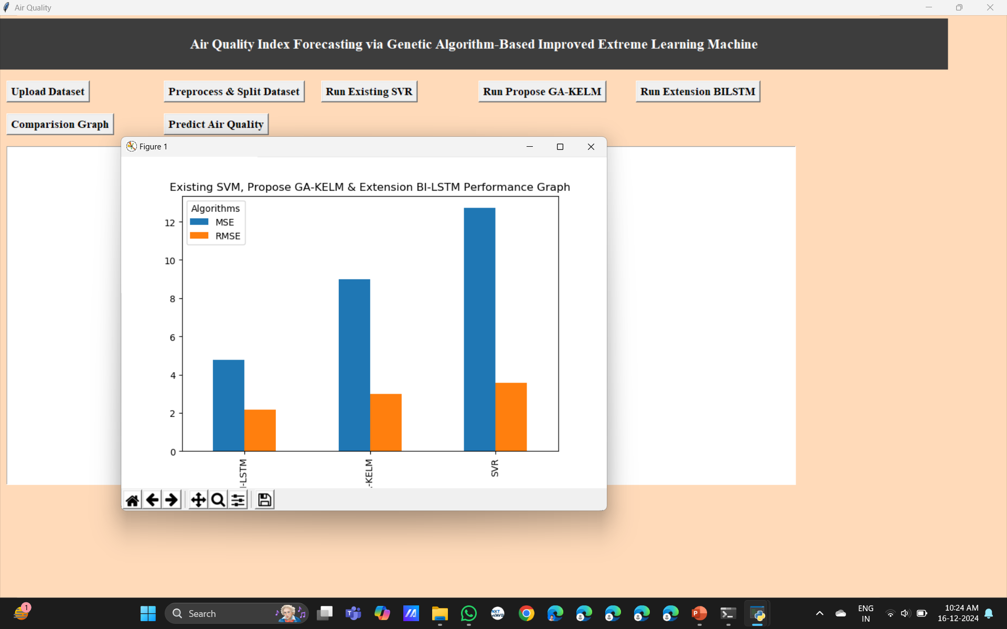
OUTPUT SCREENSHOTS

Slide 25
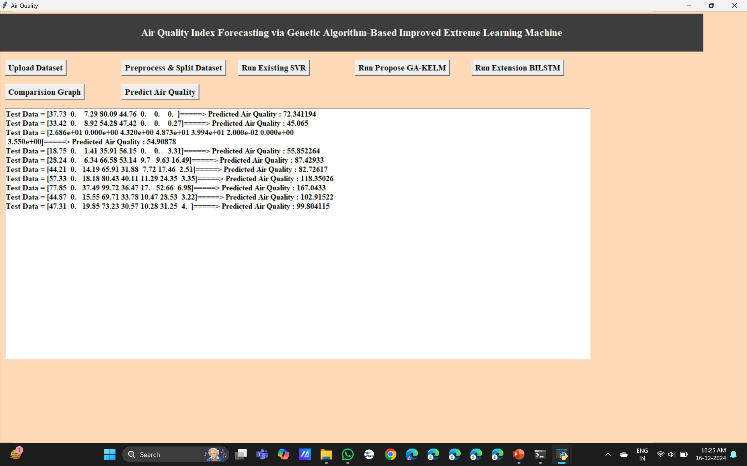
OUTPUT SCREENSHOTS

Slide 26
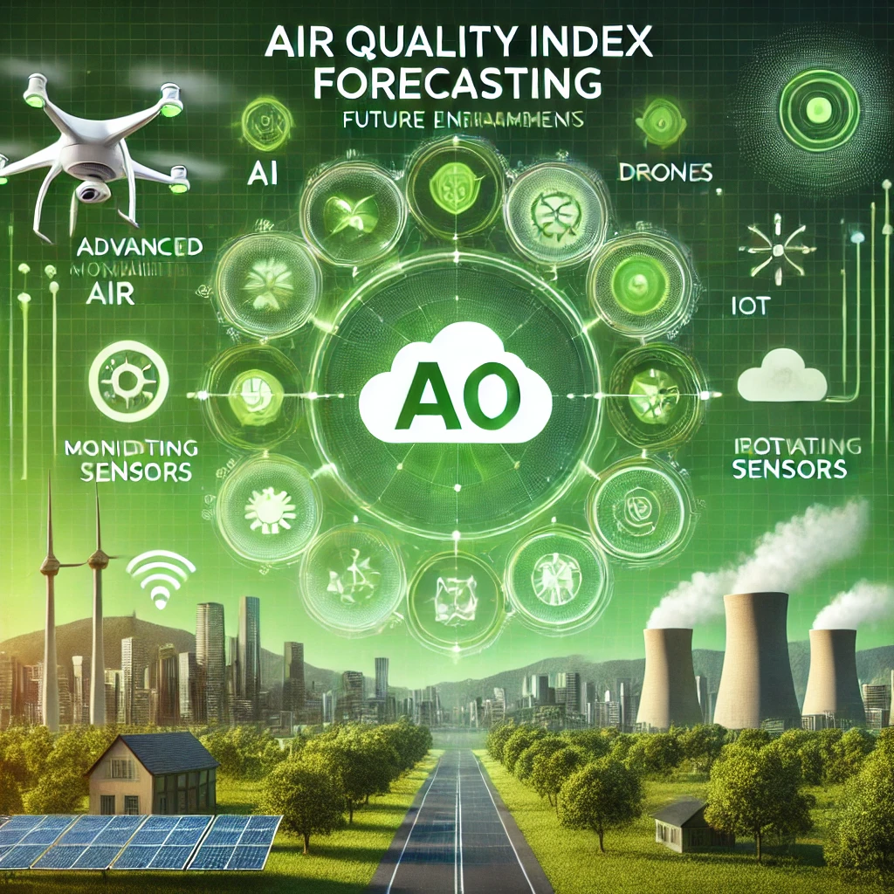
FUTURE ENHANCEMENT
To further enhance Air Quality Index (AQI) forecasting using a Genetic Algorithm-based improved Extreme Learning Machine (GA-IELM), future research could focus on incorporating more complex data sources like satellite imagery, real-time traffic data, and detailed weather patterns, optimizing feature engineering techniques, and implementing advanced model architectures for improved accuracy and adaptability across diverse environmental conditions

Slide 27
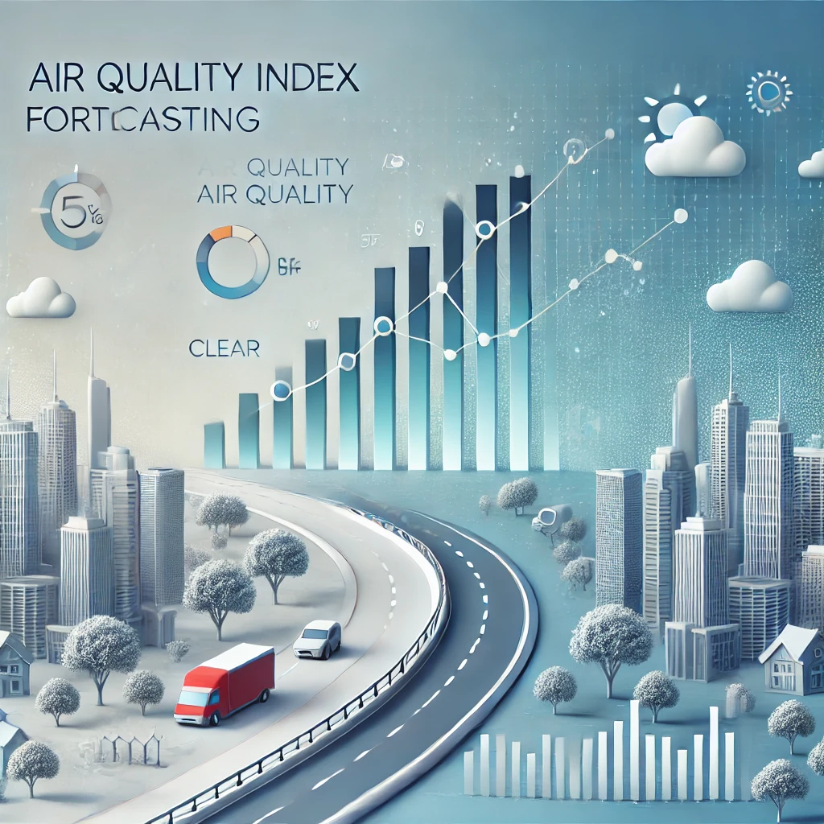
CONCLUSION
A study utilizing a Genetic Algorithm-based Improved Extreme Learning Machine (GA-KELM) for Air Quality Index (AQI) forecasting concludes that this approach provides a highly accurate and reliable method for predicting air quality, significantly outperforming traditional models like Support Vector Regression (SVR) and Deep Belief Network-Backpropagation (DBN-BP) by leveraging the optimization power of the genetic algorithm to fine-tune the KELM parameters, making it well-suited for real-world air quality prediction scenarios with complex data patterns; the integration of images further enhances the model's ability to capture spatial variations in pollution levels, leading to more precise forecasts.

Slide 28


